Slide 1
Research project
Arun Kumar Rajasekaran

Slide 2
Let’s think about timeline

Slide 3
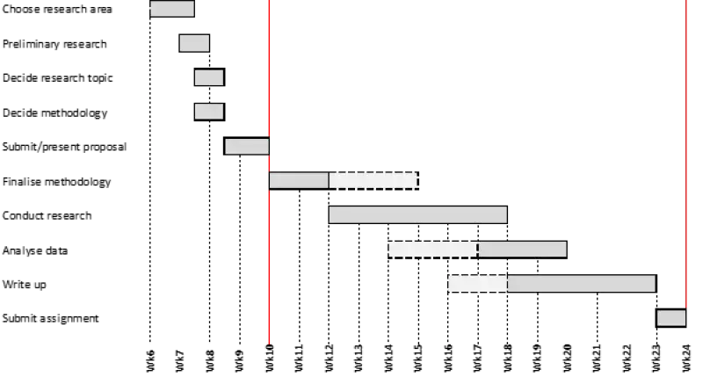
Is there a hard rule?

Slide 4
Starting a research project

Slide 5
1. Choose your research area
WHY did you choose the topic? What interests you about it? Do you have an opinion about the issues involved?
WHO are the information providers on this topic? Who might publish information about it? Who is affected by the topic? Do you know of organizations or institutions affiliated with the topic?
WHAT are the major questions for this topic? Is there a debate about the topic? Are there a range of issues and viewpoints to consider?
WHERE is your topic important: at the local, national or international level? Are there specific places affected by the topic?
WHEN is/was your topic important? Is it a current event or an historical issue? Do you want to compare your topic by time periods?

Slide 6
If you plan to propose an original topic, here are some tips to guide you:
Read a wide range of materials to find a subject that you are passionate about.
Immerse yourself in journal articles and theses associated with your topic.
Narrow your focus to a single research question. Be specific, original and realistic about what you're able to achieve.
Take a flexible approach. As your research develops, it is likely that some of your initial ideas will be challenged. You might need to change or modify your question if necessary.
Make sure you stay up-to-date with the most recent developments in your field. This will ensure your idea is achievable and that it has not already been addressed by another researcher.

Slide 7
2. Conduct preliminary research (scope out the topic)
Survey current research surrounding your chosen subject area.
Reflect on it carefully, and take advice from academic staff to establish what has already been written on your chosen subject area.
This will enable you to identify what you can do that has not been done before.

Slide 8
3. Decide your research topic
Clearly define and delineate your research topic.
The more clearly you do so the more confidence and clarity you will have in what you are trying to achieve, and the easier it will be for you to monitor your progress.
If you’re uncertain what you’re trying to achieve, how will you know whether you’re on course or not?

Slide 9
3. Decide your research topic
At this stage you might also formulate a provisional research question – that is, the question your research will answer:
Research topic: Investigate ‘A’ and ‘B’ to see if/how they interrelate.
Research Question: ‘To what extent is A caused by B?’

Slide 10
4. Decide your methodology
The research methods you use depend on the type of data you need to answer your research question.
If you want to measure something or test a hypothesis, use quantitative methods. If you want to explore ideas, thoughts and meanings, use qualitative methods.
If you want to analyze a large amount of readily-available data, use secondary data. If you want data specific to your purposes with control over how it is generated, collect primary data.
If you want to establish cause-and-effect relationships between variables, use experimental methods. If you want to understand the characteristics of a research subject, use descriptive methods.

Slide 11
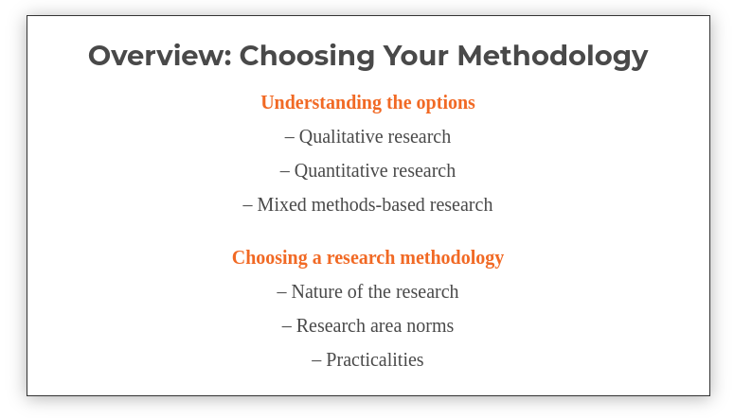
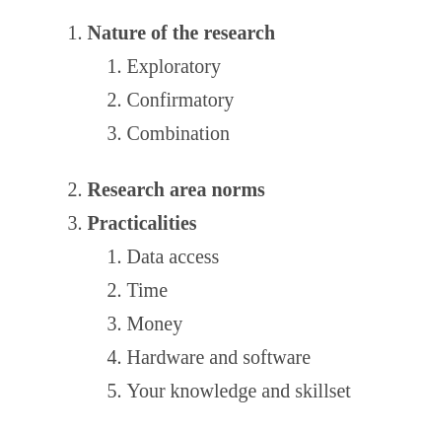
4. Decide your methodology

Slide 12
5. Submit/present your research proposal for approval
Your main research question/problem/title
Questions or concerns that will help you solve your main research problem
A brief literature review or list of key texts/sources
An overview of your methodology
A timeline showing your main research project tasks

Slide 13
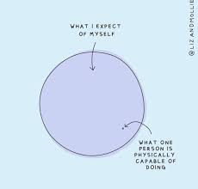

6. Finalise your topic and methodology
Revise your research plan in the light of feedback you receive during the approval process.

Slide 14

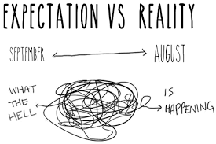

7. Conduct your research

Slide 15
8. Analysis/data processing
9. Writing up
10. Submission
10. Future works (Journal writing / extending project)

Slide 16
Few initial writing tips
Organize your thoughts, ideas, and action in a logical manner.
Provide clear descriptions.
Simplify your word choices | Write concisely | Select the appropriate words.
Optimize paragraph and sentence structure.
Use transitions to control the flow.

Slide 17

Few more writing tips
Improve readability with consistent formatting
Maintain consistent use of labels, abbreviations, and acronyms
Use abbreviations and acronyms to aid the reader
Keep it short
Get the figures / tables right

Slide 18
Let’s take a 10 min break and think about:
Forget about the deeper technical background
Imagine what could be your dataset (what you think you will get)
What could be some methodology used? (ML models?)
Where does the challenge lie? Data processing (or) hyperparameters?
Can you anticipate what type of data-processing or model hyperparameters you might be dealing with?
What’s next?
The next steps and challenges ?

Slide 19
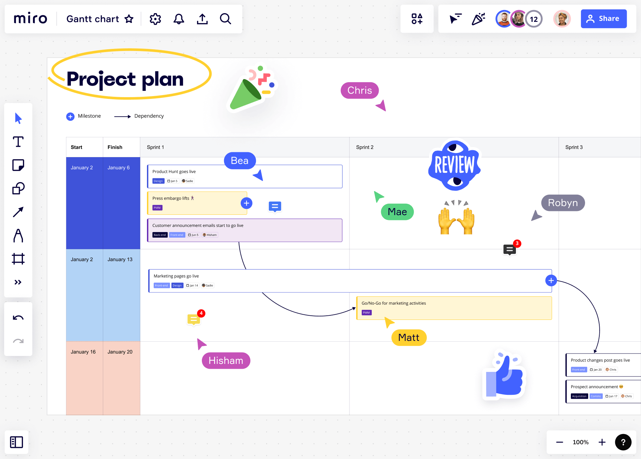
Gantt Charts
A Gantt chart is a visual representation of a project schedule and a widely used tool in project management.

Slide 20
Gantt Charts
** Excel
Notion
GanttPro (Commercial)
Miro
~ Powerpoints and other office alternatives

Slide 21
Citations/ Bibliography/ Referencing
Endnote
Researchers waste nearly 2,00,000 hours/year formatting citation! This tool simplifies formatting bibliographies, finding impact of references and full texts.
https://endnote.com/
Mendeley
Creates references, citations, and bibliographies in multiple journal styles.
https://www.mendeley.com/

Slide 22
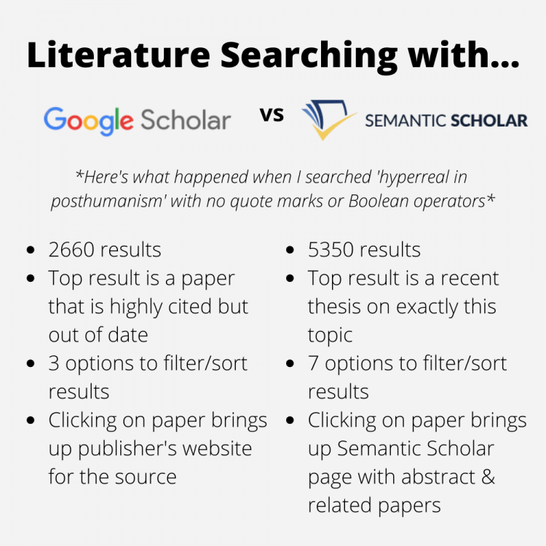
Semantic Scholar
Better than - Google scholar or Googling
~ AI powered relevant results
~ Citations

Slide 23
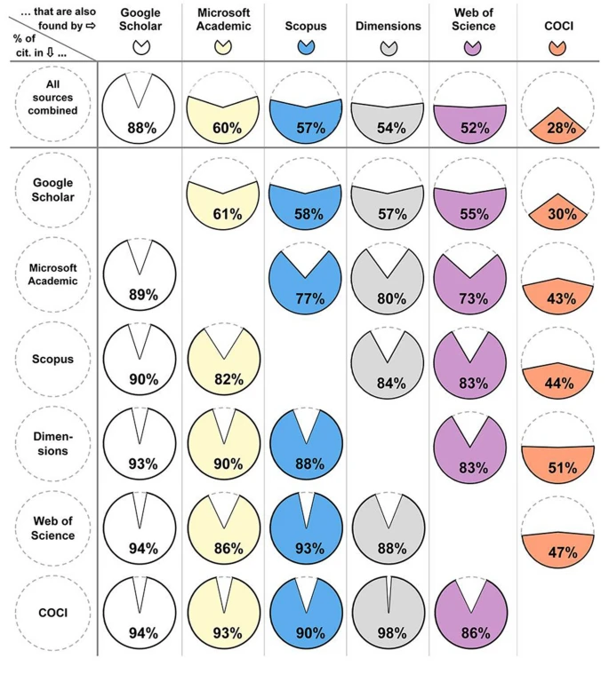
Google scholar is not bad
Martín-Martín, A., Thelwall, M., Orduna-Malea, E. et al. Google Scholar, Microsoft Academic, Scopus, Dimensions, Web of Science, and OpenCitations’ COCI: a multidisciplinary comparison of coverage via citations. Scientometrics 126, 871–906 (2021). https://doi.org/10.1007/s11192-020-03690-4

Slide 24
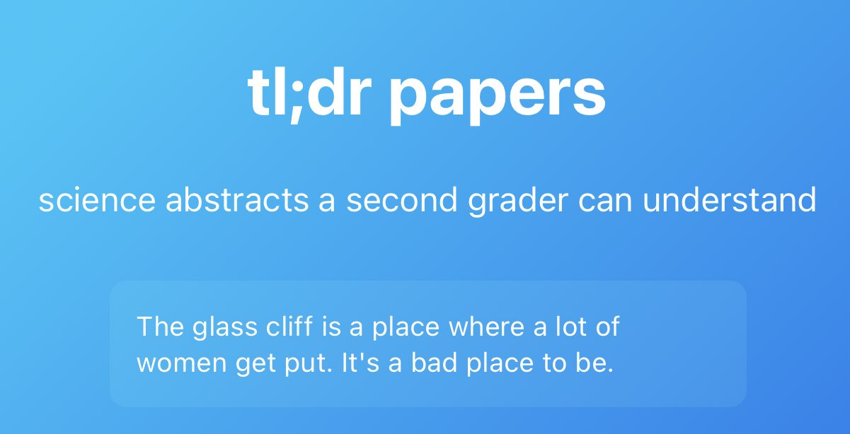
Summarizing (not my best recommendation)
Scholarcy (Commercial) - Chrome extension is free
Elicit.com
Paper digest (still in beta)

Slide 25
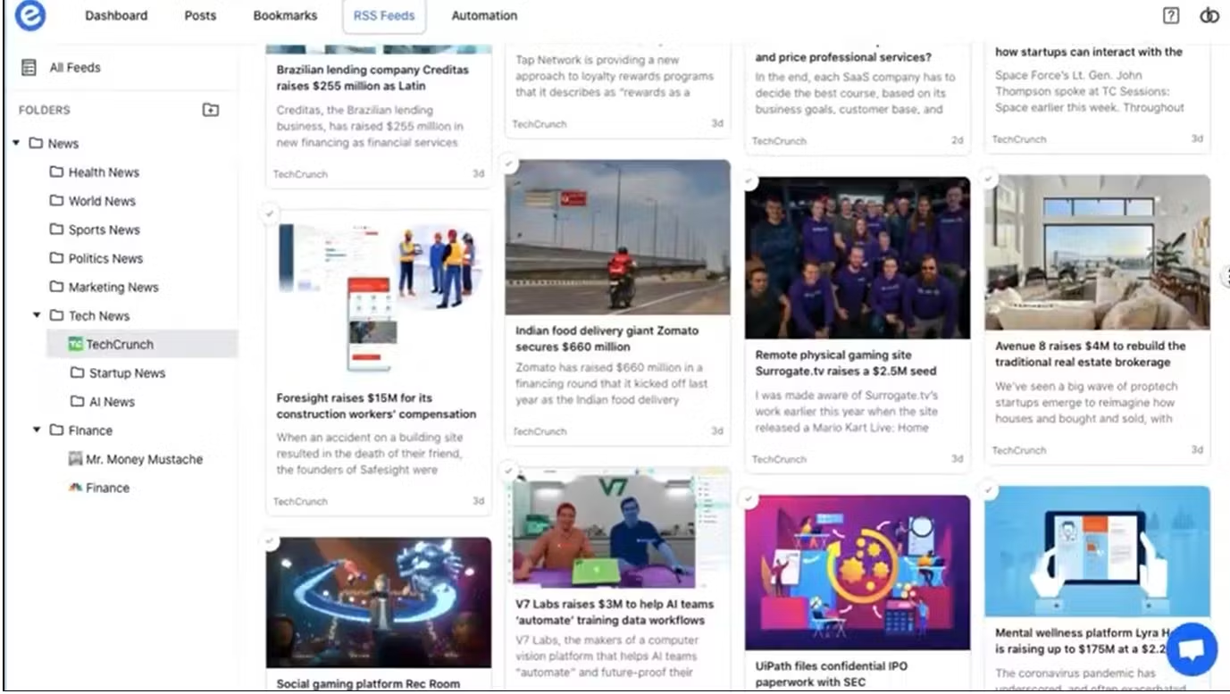
Elink.io
Enables you to save the content from around the web: articles, videos, cloud files, social media posts and share them with peers.
https://elink.io/

Slide 26
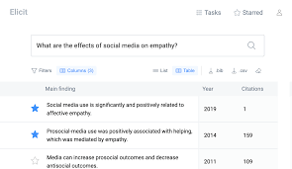
Searching without keyword
Another AI tool which helps you find relevant papers without perfect keyword match, summarize takeaways from the paper specific to your question, and extract key information from the papers.
https://elicit.org/

Slide 27
Some more unchecked AI
Scite
Allows researcher to see how publication has been cited by providing the context of citation and discover supporting and contrasting evidence for each paper.
https://scite.ai/
SciSpace Copilot
A multi-lingual AI tool, is helps you comprehend the paper (and the math and tables in it), seek answers to your queries, turn lengthy texts and sections into easy to consume summaries.
https://typeset.io/

Slide 28
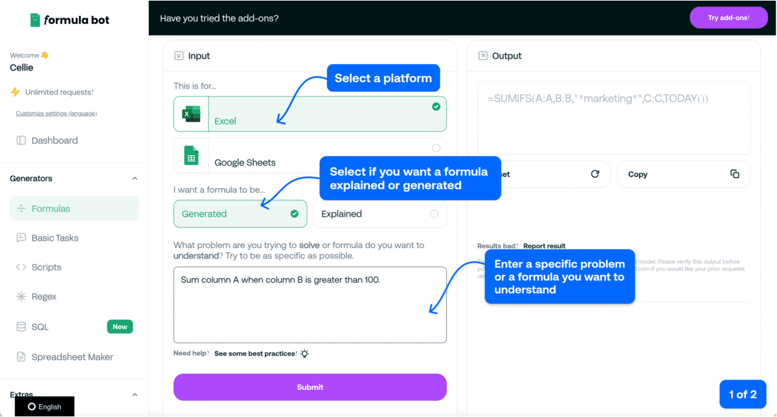
One for excel/data analysis formula
☑Data Analysis
Excel Formula Bot. Converts your text instructions into spreadsheet formula.
https://formulabot.com/?view=features

Slide 29
Spell checking
Grammarly
ProwritingAid
WordTune

Slide 30
Unchecked writing assistants
Trinka
A grammar checker and language correction AI tool for academic and technical writing; finds errors unique to academic writing that other grammar checker tools may miss.
https://www.trinka.ai/
Lex
A text editor which helps you neatly store and format documents with simple prompts including references, headers and bulleted list.
https://lex.page/
Scrivener
A tool for long writing projects. It helps you fight page fright and writer's block by letting you write text in any order and find its place in the thesis later. Helpful in keeping your notes organized.
https://lnkd.in/dtXgAQnT

